Slide 1
Bayesian Network:
Exact Inference
Session 11
Henry Lucky, S.Kom., M.Kom.

Slide 2
Learning Outcomes
Session 11
At the end of this session, students will be able to:
LO 4: Apply various techniques to an agent when acting under uncertainty

Slide 3
outline
Session 11
Bayesian Network Inference
Inference by Enumeration
Inference by Variable Elimination
Inference by Enumeration vs Variable Elimination

Slide 4
Bayesian network inference
query
What is the notation for these queries?
  What is the probability of this given what I know?
  What are the probabilities of all the possible outcomes (given what I know)?
  Which outcome is the most likely outcome (given what I know)?

Slide 5
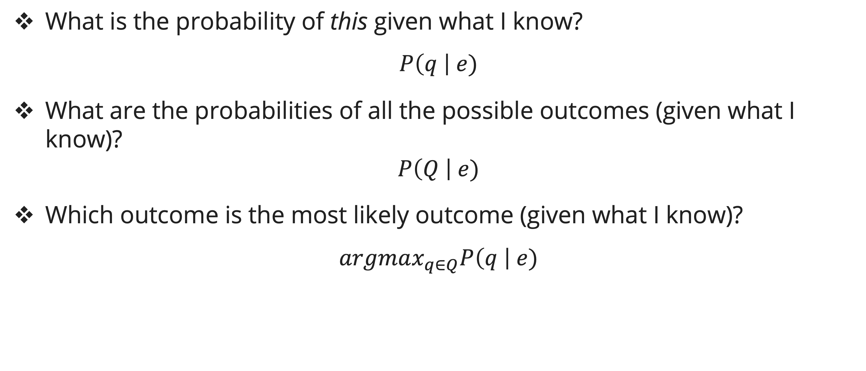
Bayesian network inference
query
What is the probability of this given what I know?
$$P\left(q \right| e)$$
What are the probabilities of all the possible outcomes (given what I know)?
$$P\left(Q \right| e)$$
Which outcome is the most likely outcome (given what I know)?
$$argmax_{q∈Q}P\left(q \right| e)$$

Slide 6
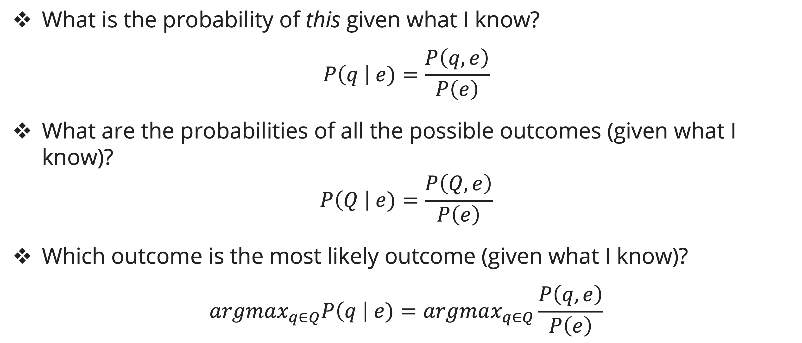
Bayesian network inference
query
What is the probability of this given what I know?
$$P\left(q \right| e)=\frac{P\left(q, e\right)}{P\left(e\right)}$$
What are the probabilities of all the possible outcomes (given what I know)?
$$P\left(Q \right| e)=\frac{P\left(Q, e\right)}{P\left(e\right)}$$
Which outcome is the most likely outcome (given what I know)?
$$argmax_{q∈Q}P\left(q \right| e)=argmax_{q∈Q}\frac{P\left(q, e\right)}{P\left(e\right)}$$

Slide 7
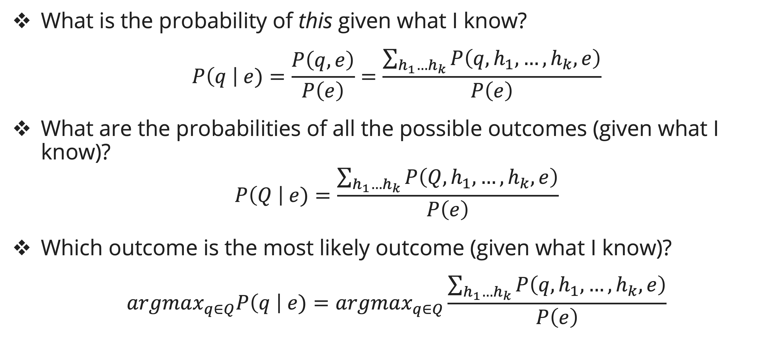
Bayesian network inference
query
What is the probability of this given what I know?
$$P\left(q \right| e)=\frac{P\left(q, e\right)}{P\left(e\right)}=\frac{\sum_{h_{1}…h_{k}}{P\left(q, h_{1}, …, h_{k},e\right)}}{P\left(e\right)}$$
What are the probabilities of all the possible outcomes (given what I know)?
$$P\left(Q \right| e)=\frac{\sum_{h_{1}…h_{k}}{P\left(Q, h_{1}, …, h_{k},e\right)}}{P\left(e\right)}$$
Which outcome is the most likely outcome (given what I know)?
$$argmax_{q∈Q}P\left(q \right| e)=argmax_{q∈Q}\frac{\sum_{h_{1}…h_{k}}{P\left(q, h_{1}, …, h_{k},e\right)}}{P\left(e\right)}$$

Slide 8
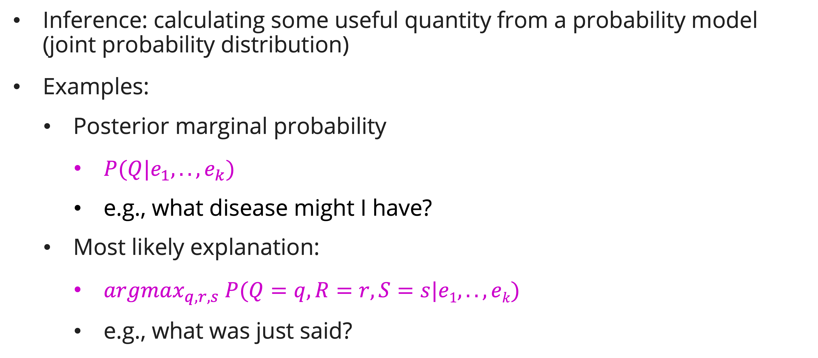
Bayesian network inference
inference
Inference: calculating some useful quantity from a probability model (joint probability distribution)
Examples:
  Posterior marginal probability
    $P(Q|e_{1},..,e_{k})$
    e.g., what disease might I have?
  Most likely explanation:
    $argmax_{q, r, s} P(Q=q,R=r,S=s|e1,..,ek)$
    e.g., what was just said?

Slide 9
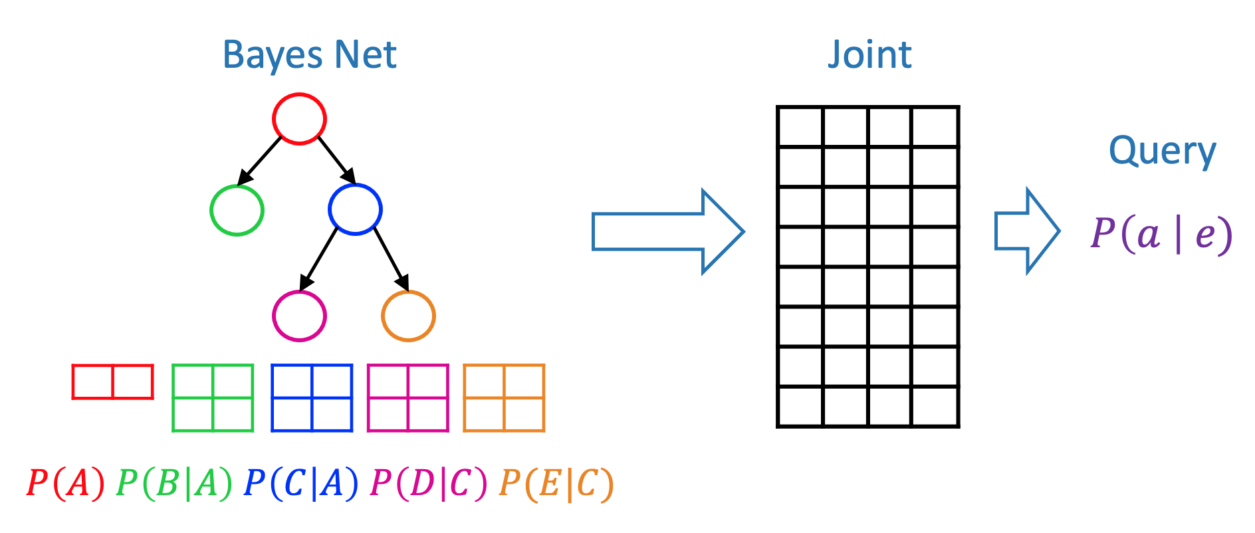
Bayesian network inference
inference
We can answer any query using the full joint distribution

Slide 10
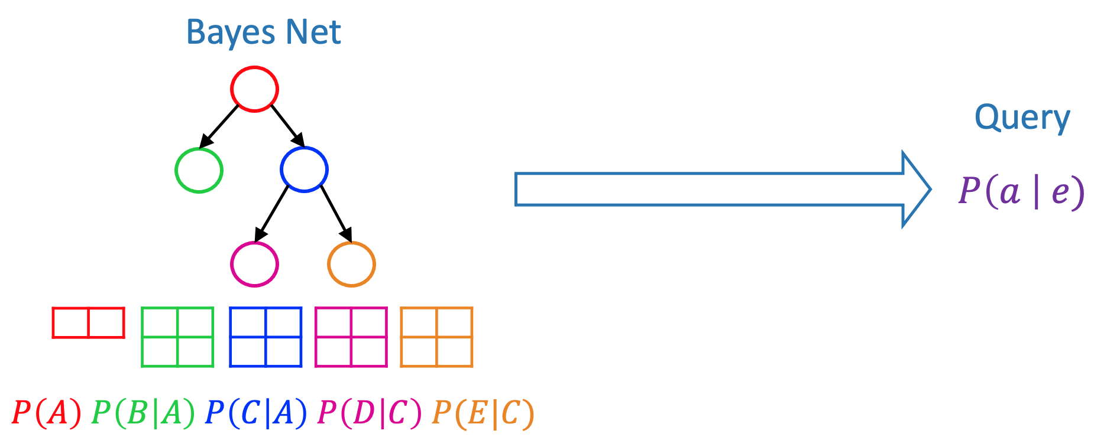
Bayesian network inference
inference
Now we’ll learn how to answer any query using Bayesian network

Slide 11
Inference by enumeration
Definition
Inference by enumeration:
  Any probability of interest can be computed by summing entries from the joint distribution
  Entries from the joint distribution can be obtained from a BN by multiplying the corresponding conditional probabilities
So, inference in Bayes nets means computing sums of products of numbers, sounds easy!!

Slide 12
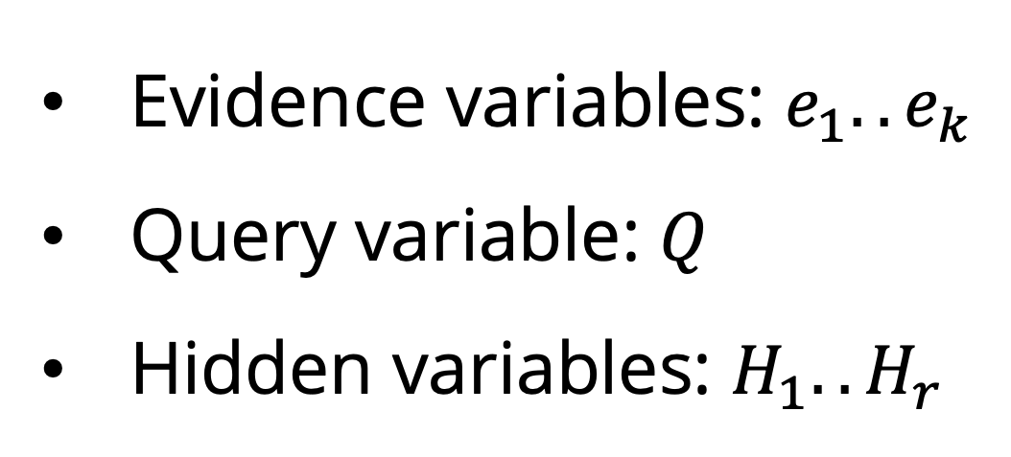
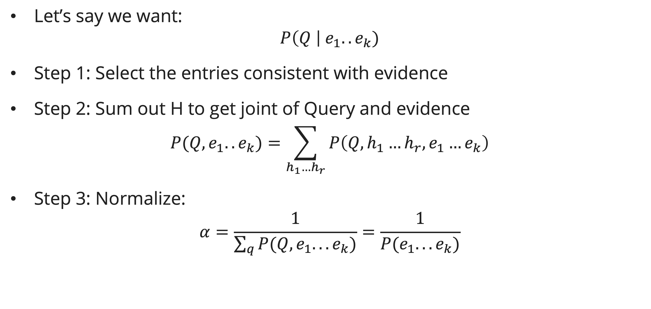
Inference by enumeration
Evidence variables: $e_{1}..e_{k}$
Query variable: $Q$
Hidden variables: $H_{1}..H_{r}$
General case
Let’s say we want:
$$P\left(Q \right| e_{1}..e_{k})$$
Step 1: Select the entries consistent with evidence
Step 2: Sum out H to get joint of Query and evidence
$$P(Q, e_{1}..e_{k})=\sum_{h_{1}…h_{r}}{P\left(Q, h_{1}…h_{r},e_{1}…e_{k}\right)}$$
Step 3: Normalize:
$$α=\frac{1}{\sum_{q}{P(Q, e_{1}...e_{k})}}=\frac{1}{P(e_{1}...e_{k})}$$
$$P\left(Q \right| e_{1}…e_{k})=α P(Q, e_{1}…e_{k})$$

Slide 13
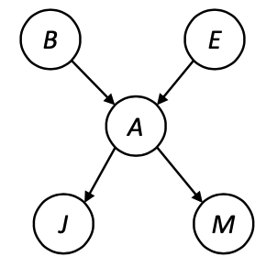
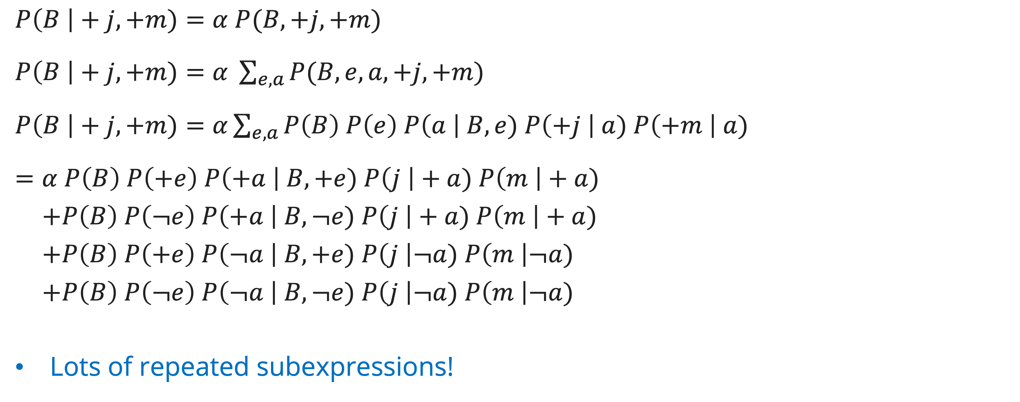
Inference by enumeration
In Bayesian network by example
$P\left(B \right|+j, +m)=α P(B, +j, +m)$
$P\left(B \right|+j, +m)=α \sum_{e, a}{P(B, e, a, +j, +m)}$
$P\left(B \right|+j, +m)=α\sum_{e, a}{P\left(B\right) P\left(e\right) P\left(a \right| B, e) P\left(+j \right| a) P\left(+m \right| a)}$
$=α P\left(B\right) P\left(+e\right) P\left(+a \right| B,+e) P\left(j \right|+a) P\left(m \right|+a)$
$+P\left(B\right) P\left(¬e\right) P\left(+a \right| B,¬e) P\left(j \right|+a) P\left(m \right|+a)$
$+P\left(B\right) P\left(+e\right) P\left(¬a \right| B,+e) P\left(j \right|¬a) P\left(m \right|¬a)$
$+P\left(B\right) P\left(¬e\right) P\left(¬a \right| B,¬e) P\left(j \right|¬a) P\left(m \right|¬a)$
Lots of repeated subexpressions!

Slide 14
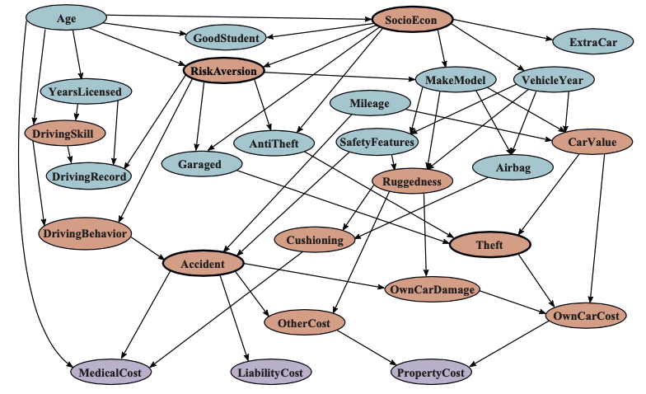
Inference by enumeration
Doing Enumeration here??

Slide 15
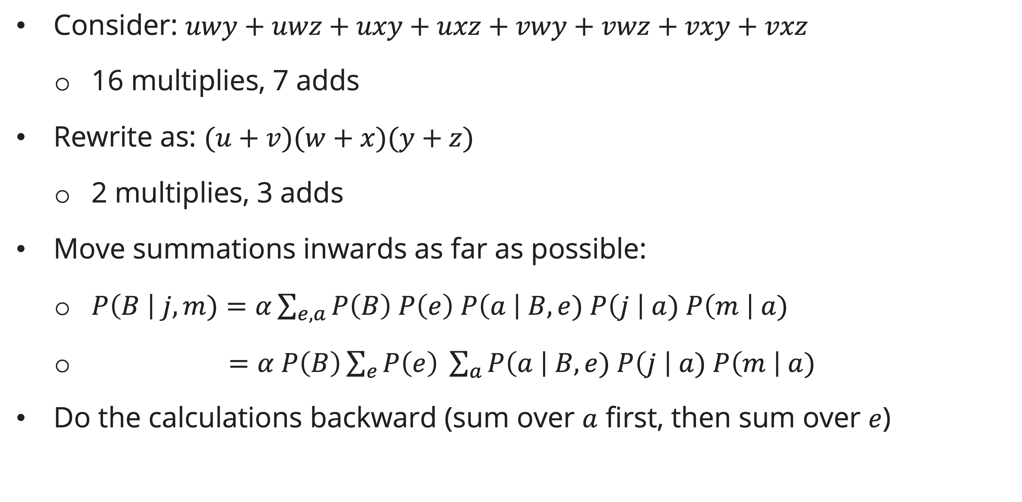
Inference by variable elimination
Basic ideas
Consider: $uwy+uwz+uxy+uxz+vwy+vwz+vxy+vxz$
  16 multiplies, 7 adds
Rewrite as: $(u+v)(w+x)(y+z)$
  2 multiplies, 3 adds
Move summations inwards as far as possible:
  $P\left(B \right| j, m)=α\sum_{e, a}{P\left(B\right) P\left(e\right) P\left(a \right| B, e) P\left(j \right| a) P\left(m \right| a)}$
  $P\left(B \right| j m)=α P\left(B\right)\sum_{e}{P\left(e\right) \sum_{a}{P\left(a \right| B, e) P\left(j \right| a) P\left(m \right| a})}$
Do the calculations backward (sum over $a$ first, then sum over $e$)

Slide 16
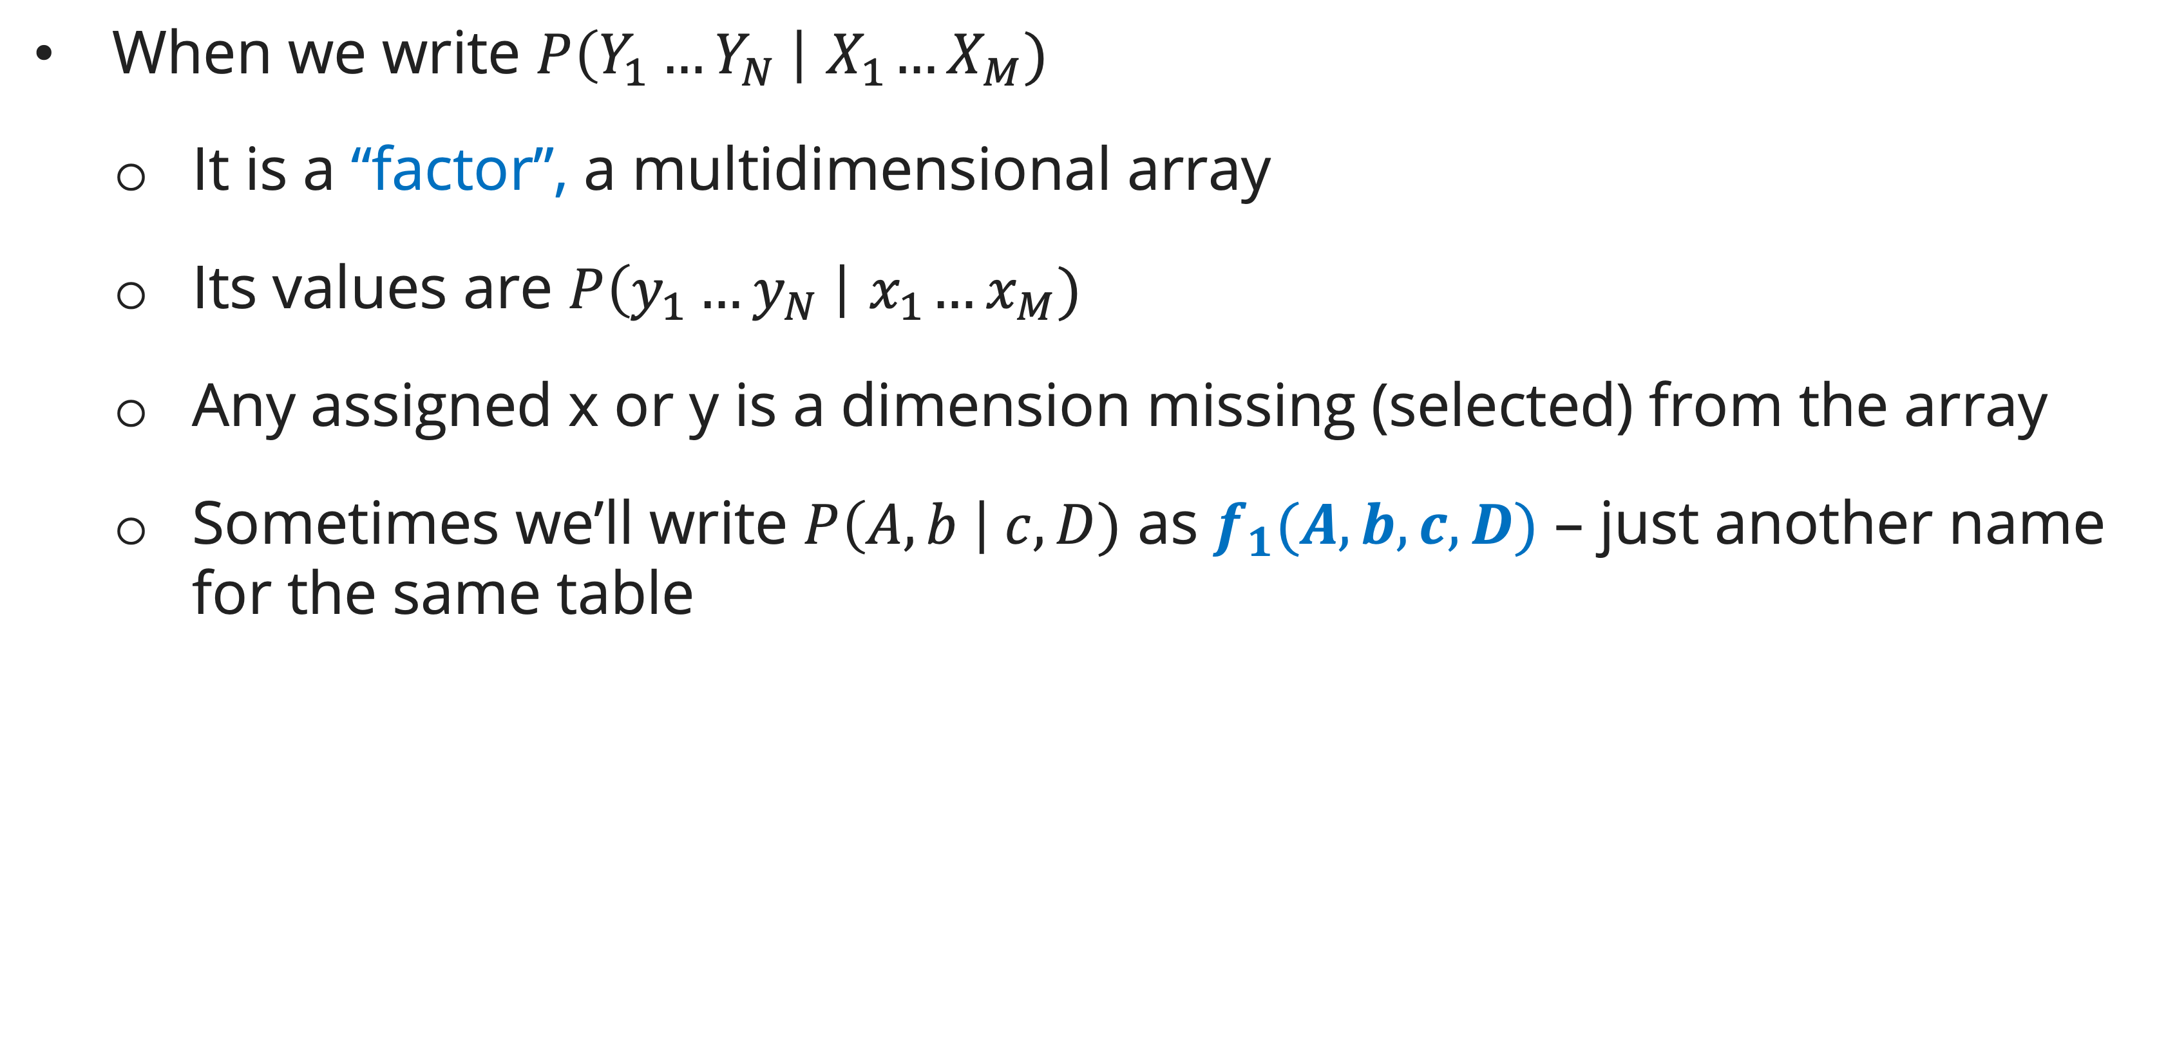
Inference by variable elimination
factor
When we write $P\left(Y_{1}…Y_{N} \right|{ X}_{1}…X_{M})$
  It is a “factor”, a multidimensional array
  Its values are $P\left(y_{1}…y_{N} \right|{ x}_{1}…x_{M})$
  Any assigned x or y is a dimension missing (selected) from the array
  Sometimes we’ll write $P\left(A, b \right| c, D)$ as $f_{1}(A, b,c, D)$ – just another name for the same table

Slide 17
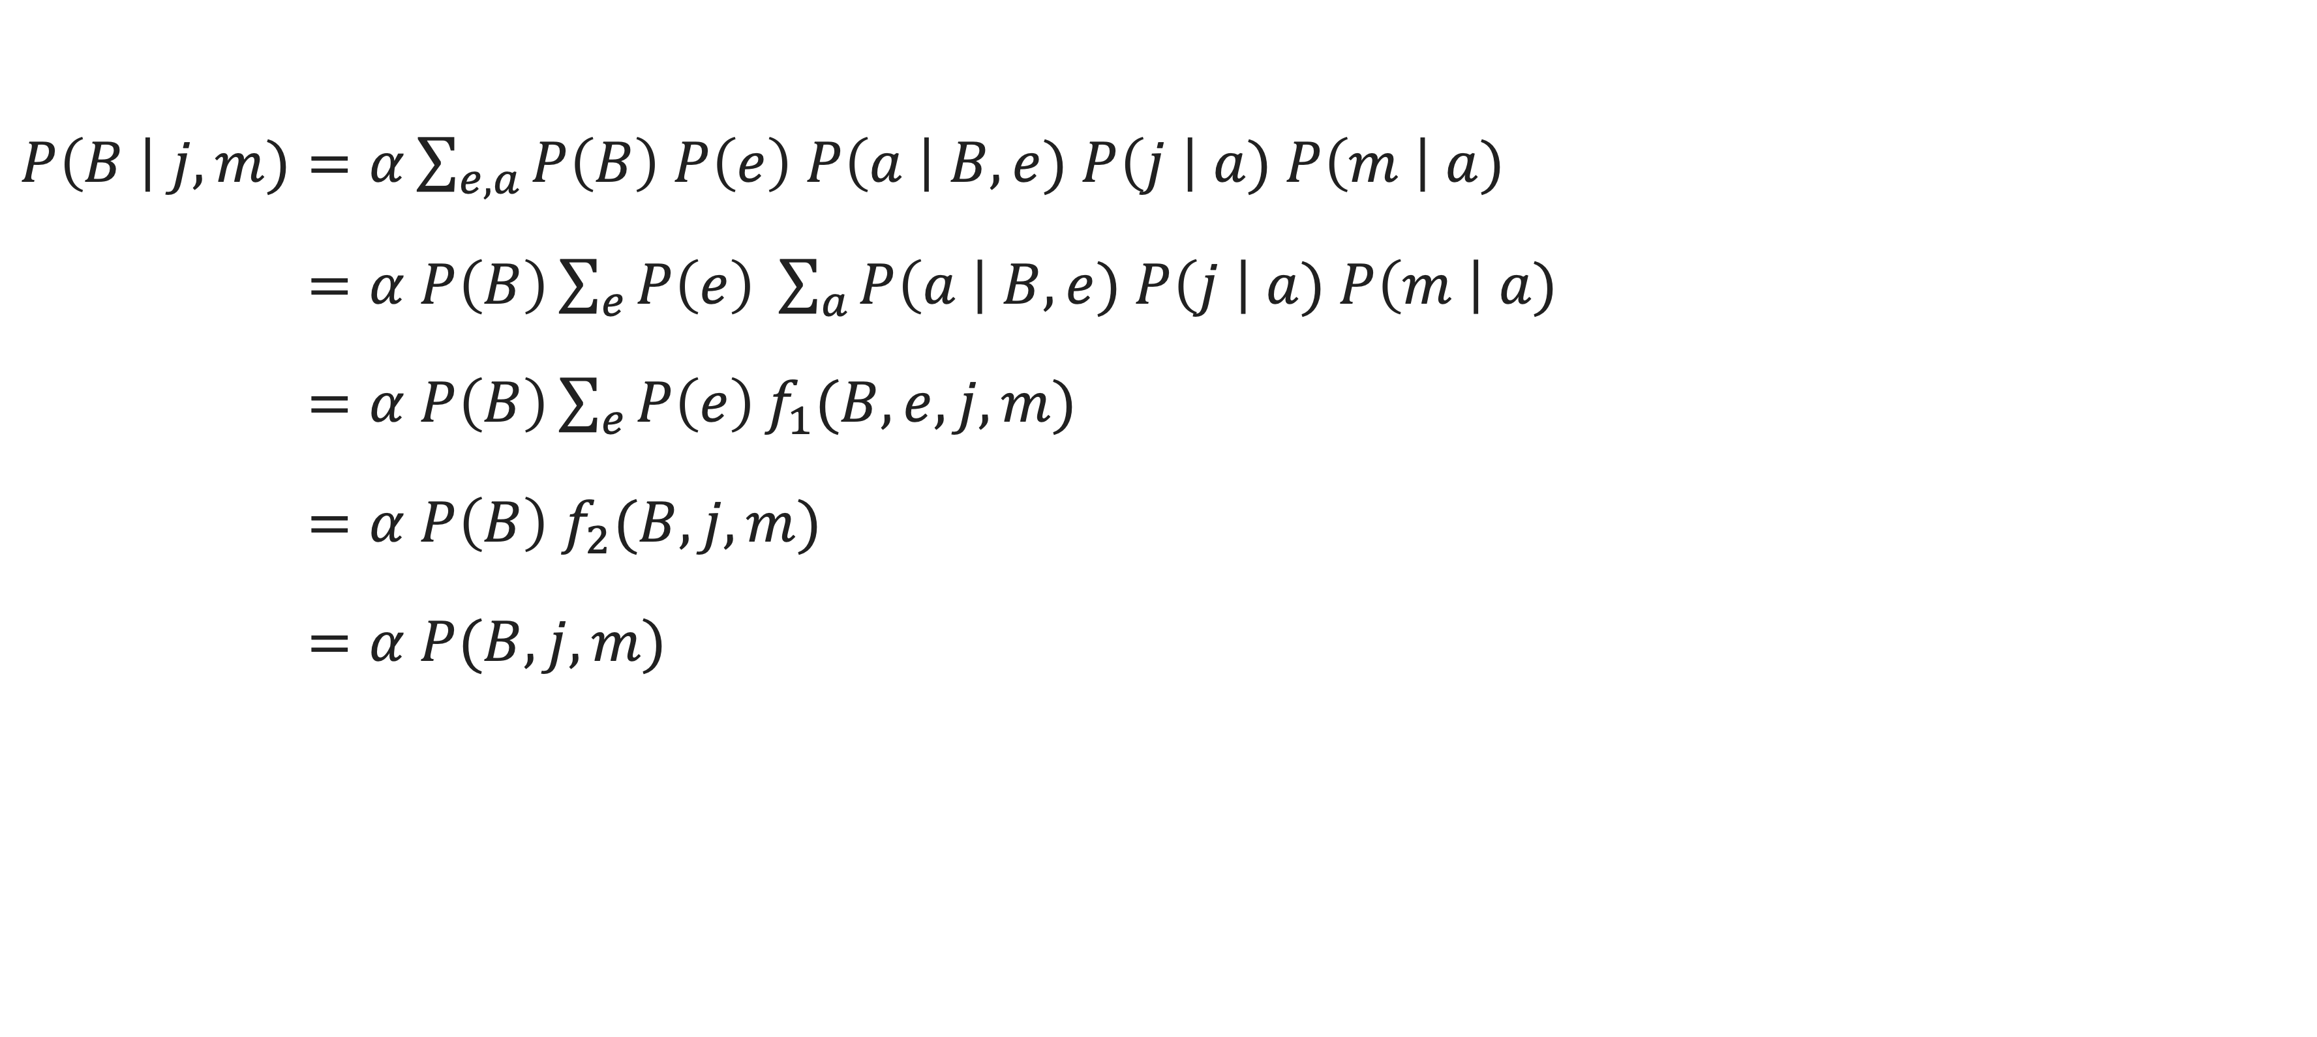
Inference by variable elimination
In Bayesian network by example
$P\left(B \right| j, m)=α\sum_{e, a}{P\left(B\right) P\left(e\right) P\left(a \right| B, e) P\left(j \right| a) P\left(m \right| a)}$
$P\left(B \right| j, m)=α P\left(B\right)\sum_{e}{P\left(e\right) \sum_{a}{P\left(a \right| B, e) P\left(j \right| a) P\left(m \right| a})}$
$P\left(B \right| j, m)=α P\left(B\right)\sum_{e}{P\left(e\right)}f_{1}(B,e,j,m)$
$P\left(B \right| j, m)=α P\left(B\right) f_{2}(B,j,m)$
$P\left(B \right| j, m)=α P(B,j,m)$

Slide 18
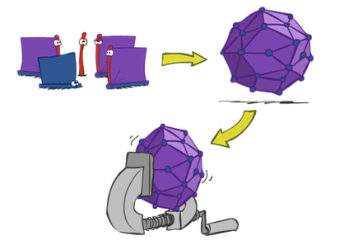
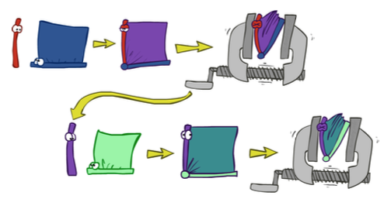
Inference by enumeration vs variable elimination
Basic difference
Inference by enumeration is slow
  Join the whole joint distribution before sum out the hidden variables (marginalizing)
Inference by variable elimination can fasten up by interleave joining and marginalizing!

Slide 19
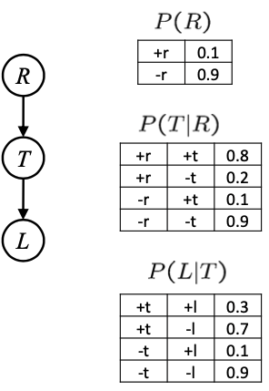
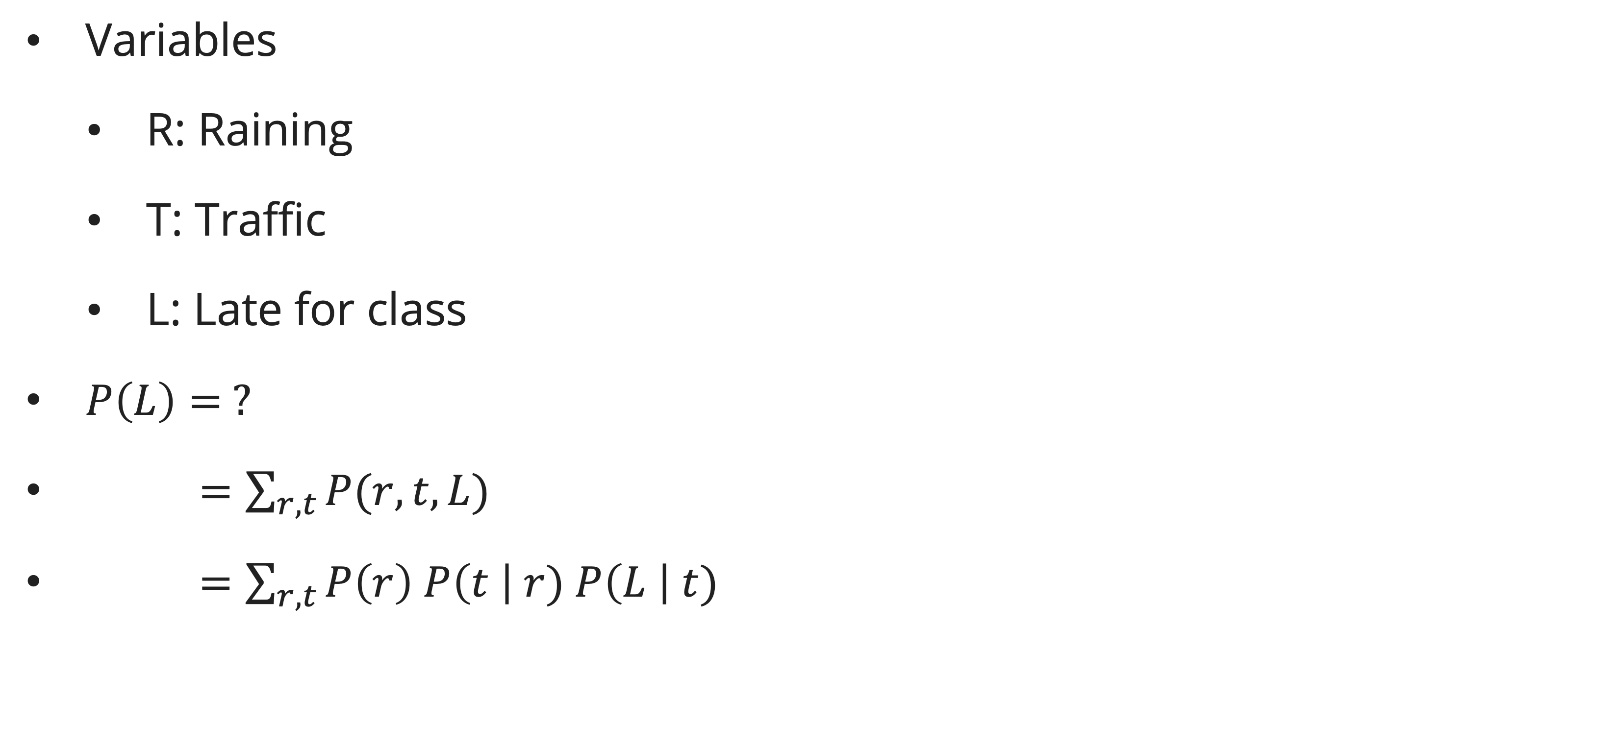
Inference by enumeration vs variable elimination
Example: Traffic domain
Variables
  R: Raining
  T: Traffic
  L: Late for class
$P\left(L\right)= ?$
$P\left(L\right)=\sum_{r,t}{P(r, t, L)}$
$P\left(L\right)=\sum_{r,t}{P\left(r\right) P\left(t \right| r) P\left(L \right| t)}$

Slide 20
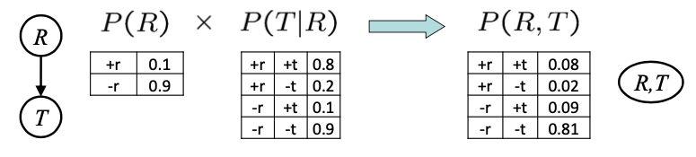
Inference by enumeration vs variable elimination
Traffic domain: Enumeration
Procedure: Join all factors, eliminate all hidden variables, normalize
First basic operation: joining factors
  Just like a database join
  Get all factors. Over the joining variable
  Build a new factor over the union of the variable involved
Example: Join on R

Slide 21
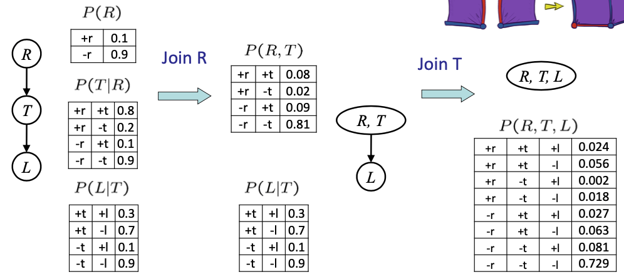
Inference by enumeration vs variable elimination
Traffic domain: Enumeration
Multiple Joins:

Slide 22
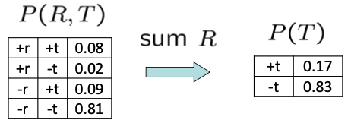
Inference by enumeration vs variable elimination
Traffic domain: Enumeration
Procedure: Join all factors, eliminate all hidden variables, normalize
Second basic operation: marginalization (eliminate)
  Take a factor and sum out a variable
  Shrinks a factor to a smaller one
  A projection operation
Example: Eliminate R

Slide 23
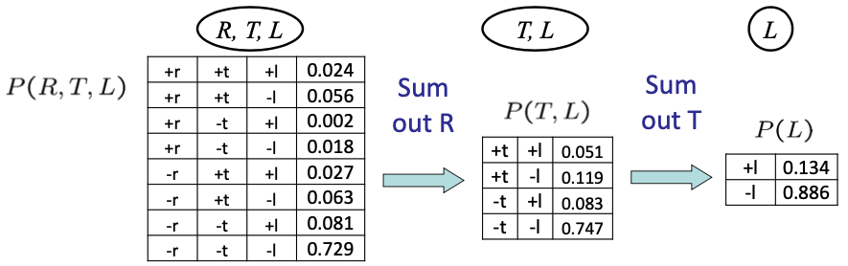
Inference by enumeration vs variable elimination
Traffic domain: Enumeration
Multiple elimination:

Slide 24
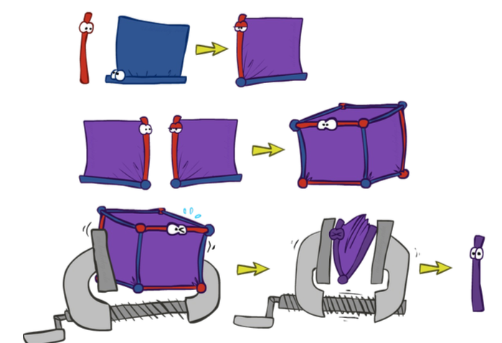
Inference by enumeration vs variable elimination
Inference by Enumeration: Multiple join, multiple eliminate

Slide 25
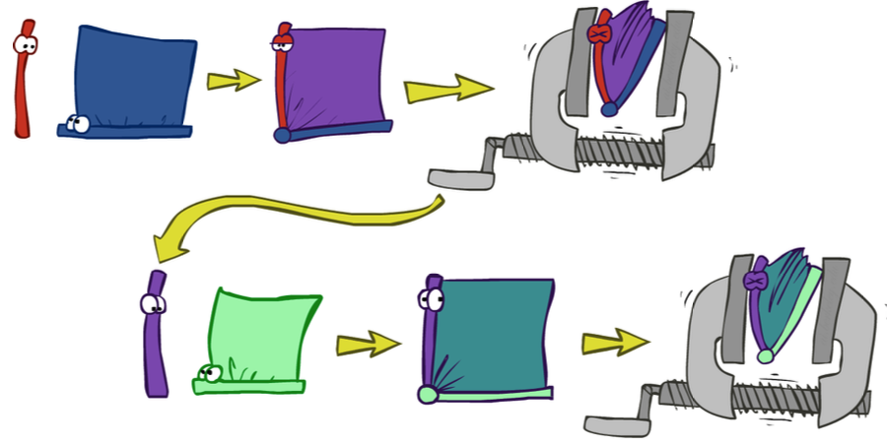
Inference by enumeration vs variable elimination
Inference by variable elimination: Marginalizing early

Slide 26
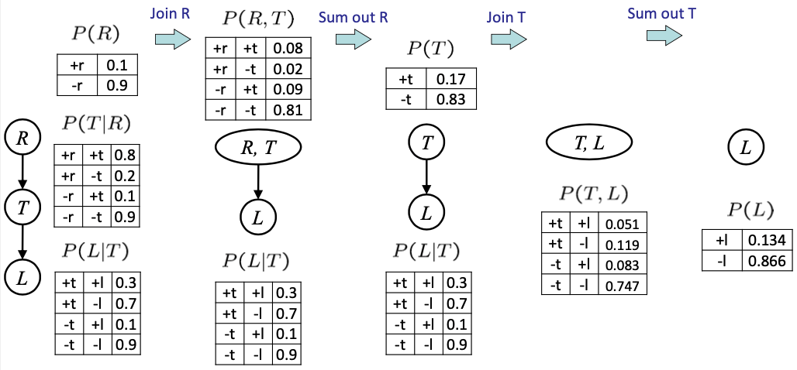
Inference by enumeration vs variable elimination
Traffic domain: variable elimination

Slide 27
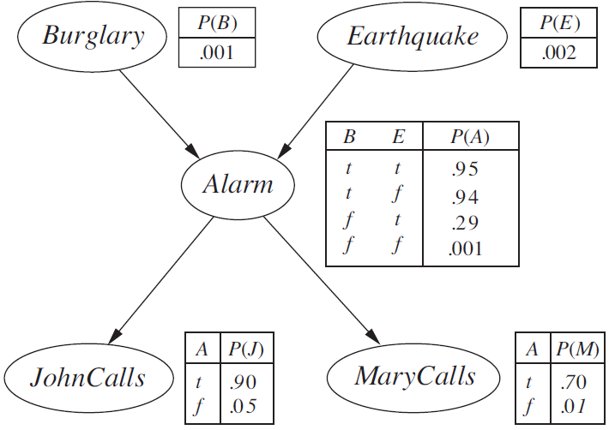
Inference by enumeration vs variable elimination
Another Example: alarm network

Slide 28
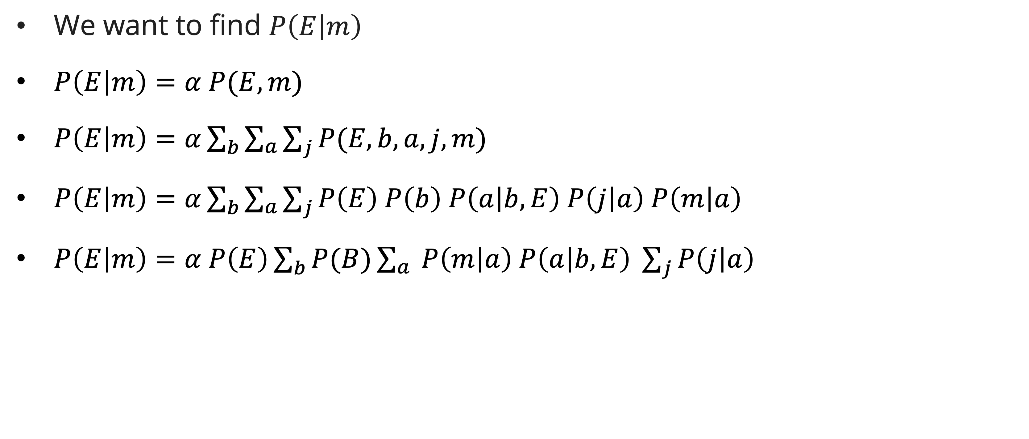
Inference by enumeration vs variable elimination
alarm network: variable elimination
We want to find $P\left(E | m\right)$
$P\left(E | m\right)=α P(E,m)$
$P\left(E | m\right)=α\sum_{b}{\sum_{a}{\sum_{j}{P(E, b, a, j,m)}}}$
$P\left(E | m\right)=α\sum_{b}{\sum_{a}{\sum_{j}{P\left(E\right) P\left(b\right) P\left(a | b,E\right) P\left(j | a\right) P\left(m | a\right)}}}$
$P\left(E | m\right)=α P\left(E\right)\sum_{b}{P(B)\sum_{a}{ P\left(m | a\right) P\left(a | b,E\right) \sum_{j}{P\left(j | a\right)}}}$

Slide 29
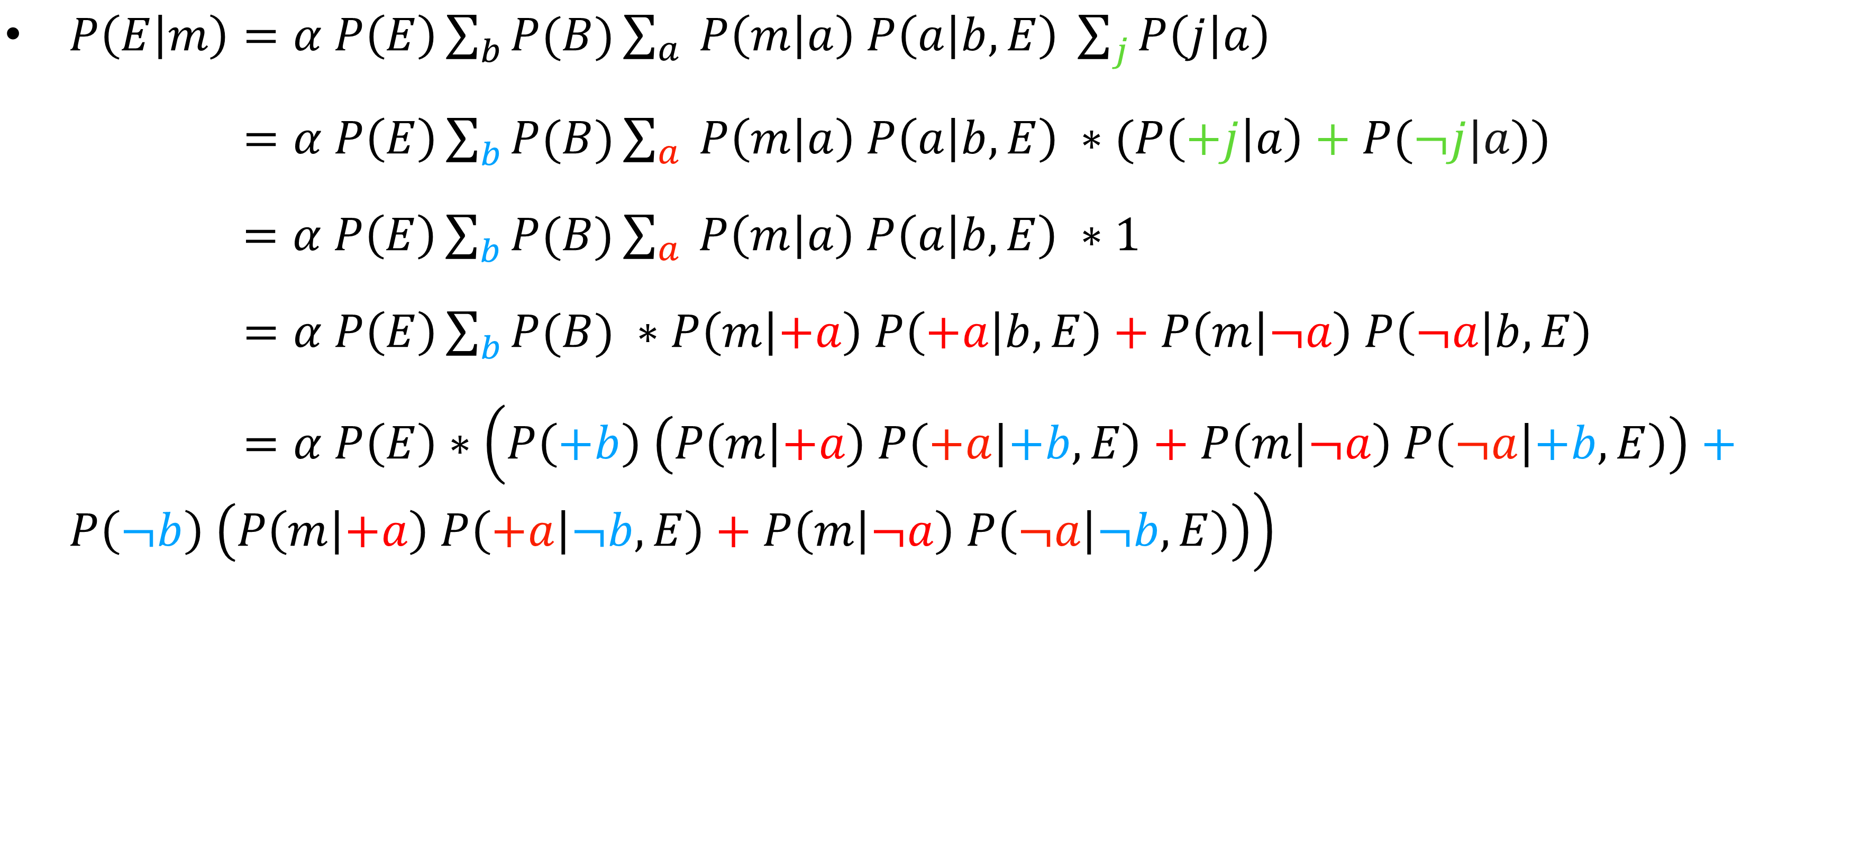
Inference by enumeration vs variable elimination
alarm network: variable elimination
$P\left(E | m\right)=α P\left(E\right)\sum_{b}{P(B)\sum_{a}{ P\left(m | a\right) P\left(a | b,E\right) \sum_{j}{P\left(j | a\right)}}}$
$P\left(E | m\right)=α P\left(E\right)\sum_{b}{P(B)\sum_{a}{ P\left(m | a\right) P\left(a | b,E\right) ∗(P\left(+j | a\right)+P(¬j|a)}})$
$=α P\left(E\right)\sum_{b}{P(B)\sum_{a}{ P\left(m | a\right) P\left(a | b,E\right) ∗1}}$
$P\left(E | m\right)=α P\left(E\right)\sum_{b}{P(B) }∗P\left(m | +a\right) P\left(+a | b,E\right)+P\left(m | ¬a\right) P\left(¬a | b,E\right)$
$P\left(E | m\right)=α P\left(E\right)∗\left(P\left(+b\right) \left(P\left(m | +a\right) P\left(+a | +b,E\right)+P\left(m | ¬a\right) P\left(¬a | +b,E\right)\right)+P\left(¬b\right) \left(P\left(m | +a\right) P\left(+a | ¬b,E\right)+P\left(m | ¬a\right) P\left(¬a | ¬b,E\right)\right)\right)$

Slide 30
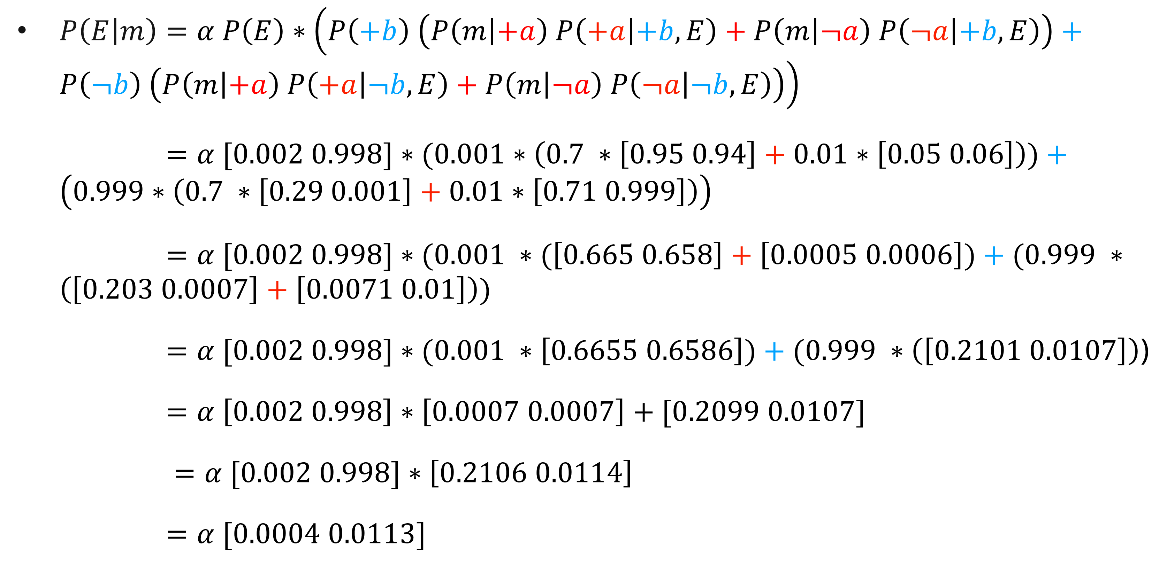
Inference by enumeration vs variable elimination
alarm network: variable elimination
$P\left(E | m\right)=α P\left(E\right)∗\left(P\left(+b\right) \left(P\left(m | +a\right) P\left(+a | +b,E\right)+P\left(m | ¬a\right) P\left(¬a | +b,E\right)\right)+P\left(¬b\right) \left(P\left(m | +a\right) P\left(+a | ¬b,E\right)+P\left(m | ¬a\right) P\left(¬a | ¬b,E\right)\right)\right)$
$P\left(E | m\right)=α [0.002 0.998]∗(0.001∗\left(0.7 ∗\left[0.95 0.94\right]+0.01∗\left[0.05 0.06\right]\right))+\left(0.999∗\left(0.7 ∗\left[0.29 0.001\right]+0.01∗\left[0.71 0.999\right]\right)\right)$
$P\left(E | m\right)=α [0.002 0.998]∗(0.001 ∗(\left[0.665 0.658\right]+\left[0.0005 0.0006\right])+(0.999 ∗\left(\left[0.203 0.0007\right]+\left[0.0071 0.01\right]\right))$
$P\left(E | m\right)=α [0.002 0.998]∗(0.001 ∗\left[0.6655 0.6586\right])+(0.999 ∗\left(\left[0.2101 0.0107\right]\right)$)
$P\left(E | m\right)=α \left[0.002 0.998\right]∗\left[0.0007 0.0007\right]+[0.2099 0.0107]$
$P\left(E | m\right)=α [0.002 0.998]∗\left[0.2106 0.0114\right]$
$P\left(E | m\right)=α [0.0004 0.0113]$
Notes:
There are only 8 multiplies and 4 adds here (including the previus $P\left(j | a\right)$). Using enumeration would need 28 multiplies and 7 adds.

Slide 31
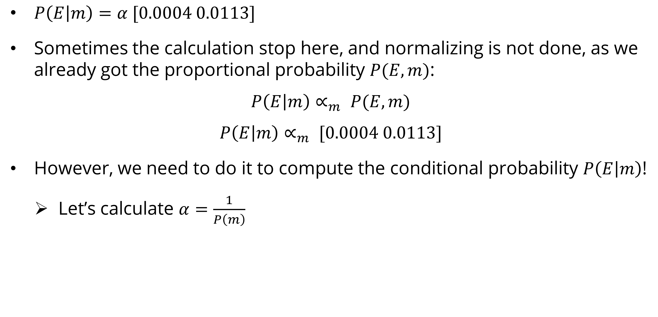
Inference by enumeration vs variable elimination
alarm network: variable elimination
$P\left(E | m\right)=α [0.0004 0.0113]$
Sometimes the calculation stop here, and normalizing is not done, as we already got the proportional probability $P(E,m)$:
$$P\left(E | m\right)∝_{m} P(E,m)$$
$$P\left(E | m\right)∝_{m} [0.0004 0.0113]$$
However, we need to do it to compute the conditional probability $P\left(E | m\right)$!
  Let’s calculate $α=\frac{1}{P\left(m\right)}$
Notes:
$X∝_{m}Y$means that X is directly proportional to Y for a constant m

Slide 32
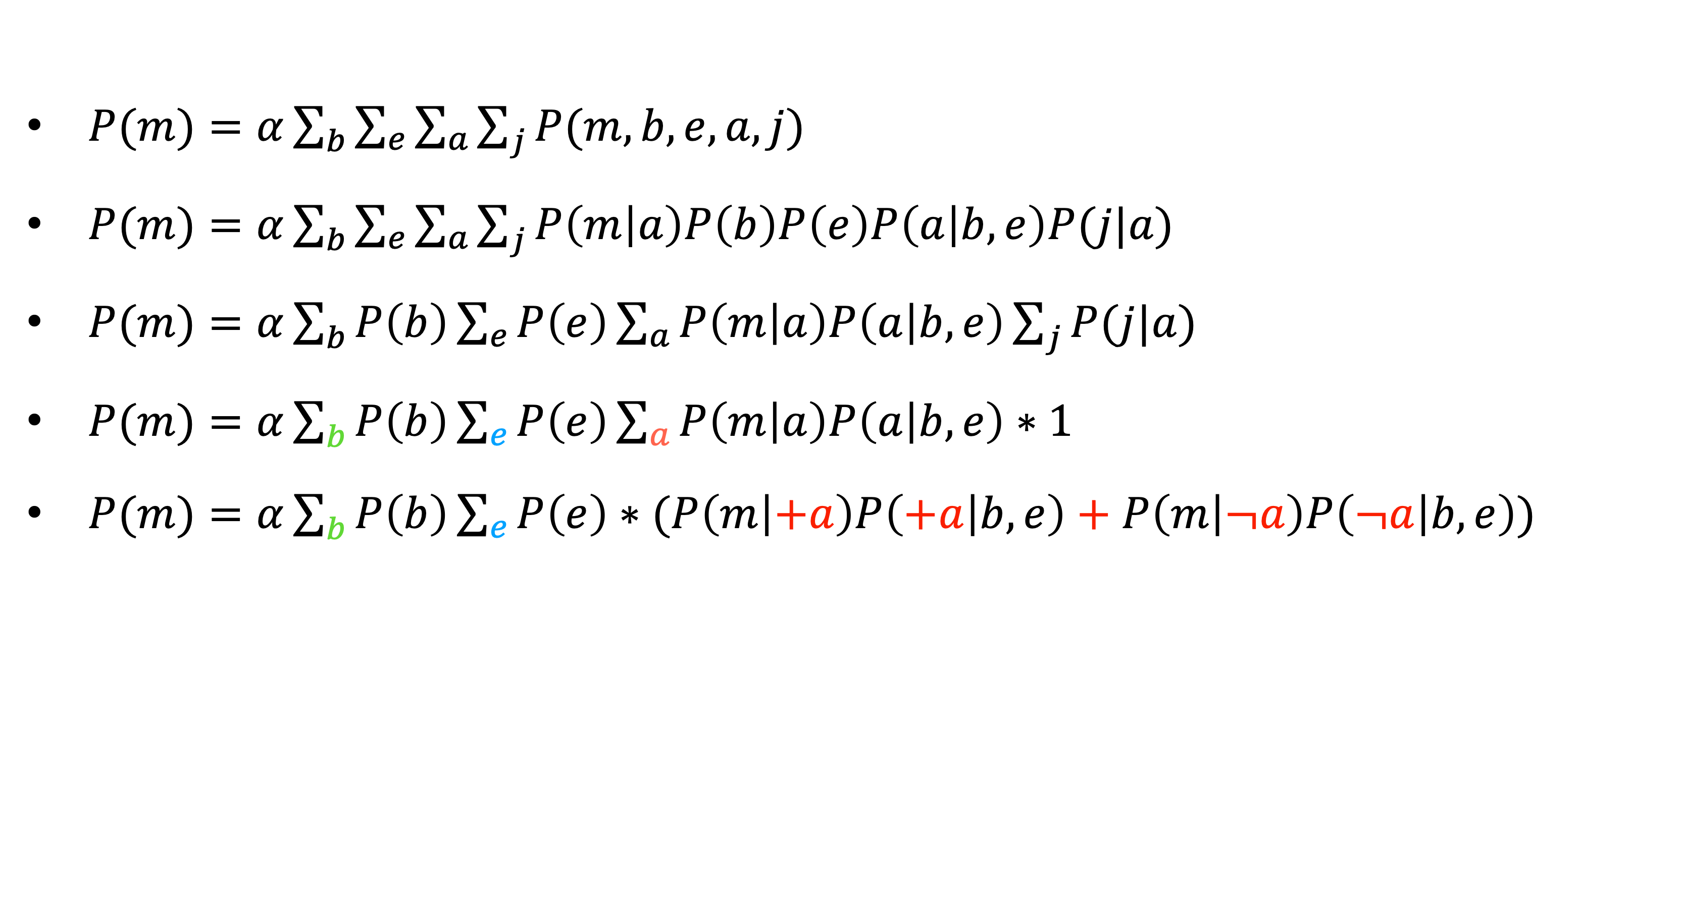
Inference by enumeration vs variable elimination
alarm network: variable elimination
$P(m)=α\sum_{b}{\sum_{e}{\sum_{a}{\sum_{j}{P(m,b, e,a, j)}}}}$
$P(m)=α\sum_{b}{\sum_{e}{\sum_{a}{\sum_{j}{P\left(m | a\right)P\left(b\right)P\left(e\right)P\left(a | b,e\right)P(j|a)}}}}$
$P(m)=α\sum_{b}{P\left(b\right)\sum_{e}{P\left(e\right)\sum_{a}{P\left(m | a\right)P\left(a | b,e\right)\sum_{j}{P(j|a)}}}}$
$P(m)=α\sum_{b}{P\left(b\right)\sum_{e}{P\left(e\right)\sum_{a}{P\left(m | a\right)P\left(a | b,e\right)∗1}}}$
$P(m)=α\sum_{b}{P\left(b\right)\sum_{e}{P\left(e\right)∗(P\left(m | +a\right)P\left(+a | b,e\right)+P\left(m | ¬a\right)P\left(¬a | b,e\right))}}$
Notes:
Using enumeration will need 60 multiplies and 15 adds

Slide 33
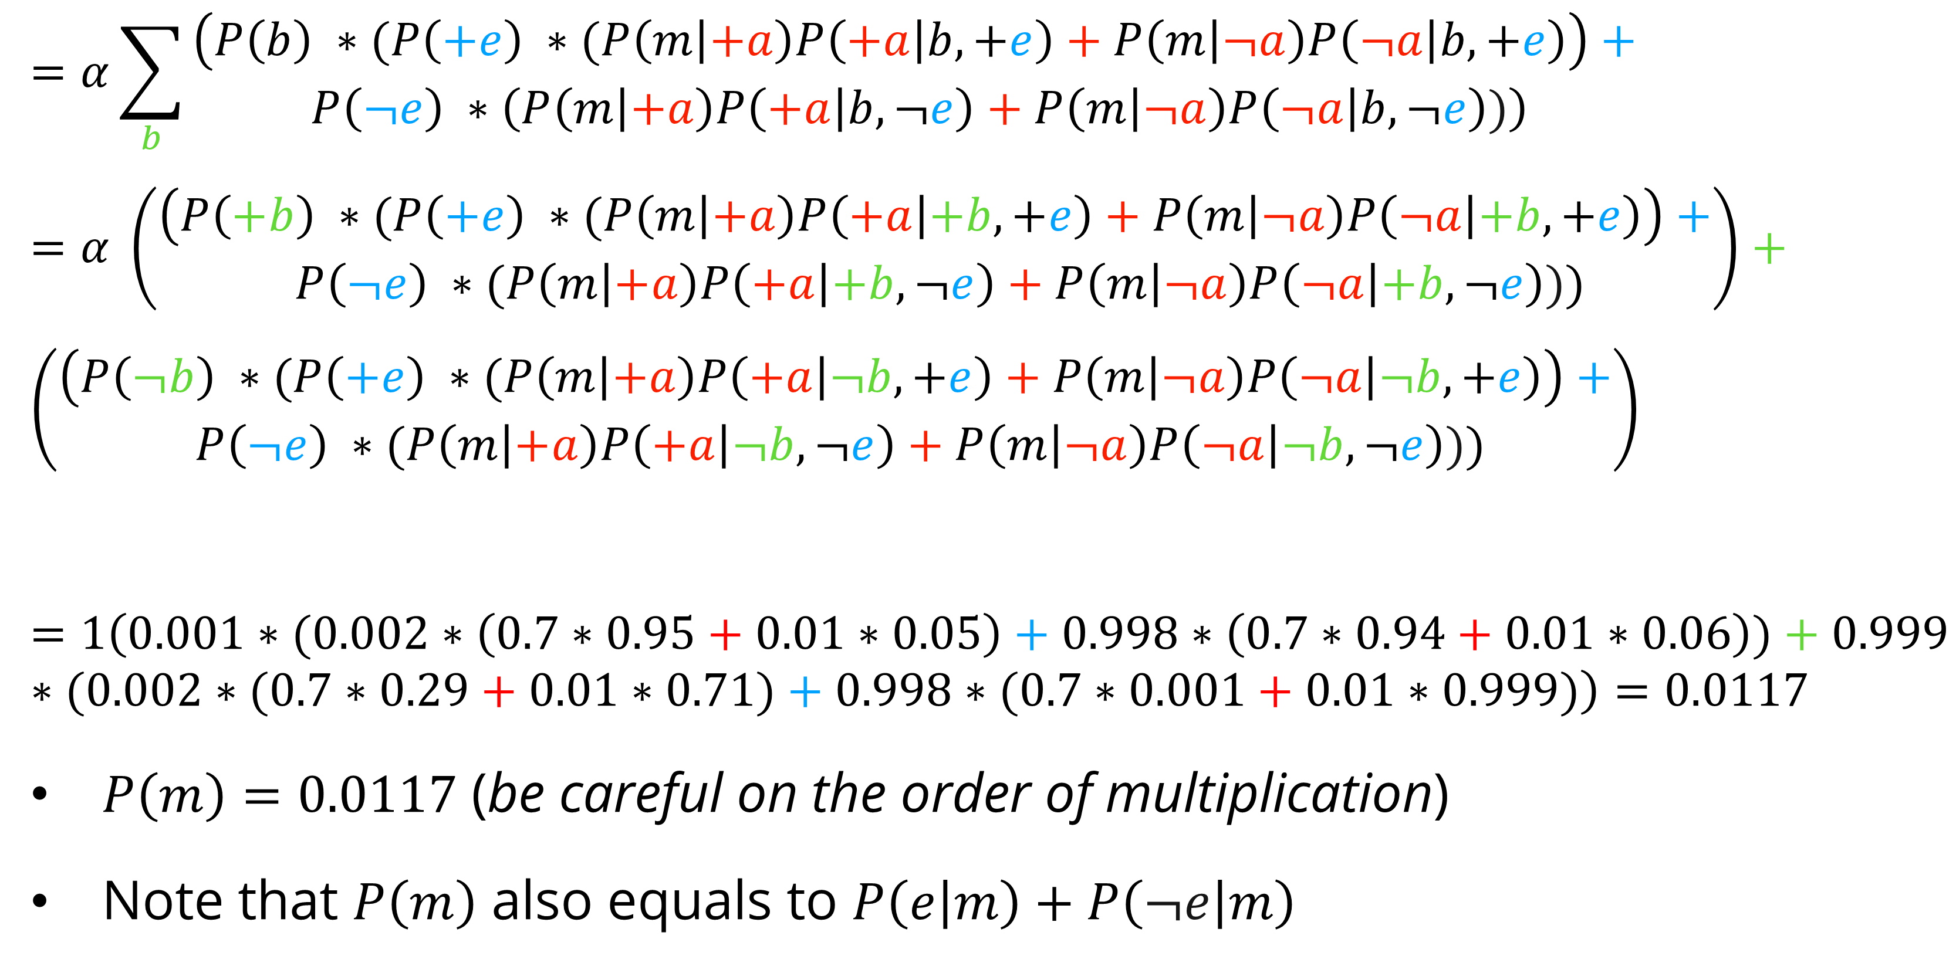
Inference by enumeration vs variable elimination
alarm network: variable elimination
$$=α\sum_{b}{\begin{aligned}\left(P\left(b\right) ∗(P\left(+e\right) ∗(P\left(m | +a\right)P\left(+a | b,+e\right)+P\left(m | ¬a\right)P\left(¬a | b,+e\right)\right)+ \\ P\left(¬e\right) ∗\left(P\left(m | +a\right)P\left(+a | b,¬e\right)+P\left(m | ¬a\right)P\left(¬a | b,¬e\right))\right)\end{aligned}}$$
$$=α \left(\begin{aligned}\left(P\left(+b\right) ∗(P\left(+e\right) ∗(P\left(m | +a\right)P\left(+a | +b,+e\right)+P\left(m | ¬a\right)P\left(¬a | +b,+e\right)\right)+ \\ P\left(¬e\right) ∗(P\left(m | +a\right)P\left(+a | +b,¬e\right)+P\left(m | ¬a\right)P\left(¬a | +b,¬e\right)))\end{aligned}\right)+$$
$$\left(\begin{aligned}\left(P\left(¬b\right) ∗(P\left(+e\right) ∗(P\left(m | +a\right)P\left(+a | ¬b,+e\right)+P\left(m | ¬a\right)P\left(¬a | ¬b,+e\right)\right)+ \\ P\left(¬e\right) ∗(P\left(m | +a\right)P\left(+a | ¬b,¬e\right)+P\left(m | ¬a\right)P\left(¬a | ¬b,¬e\right)))\end{aligned}\right)$$
$$=1\left(0.001∗(0.002∗\left(0.7∗0.95+0.01∗0.05\right)+0.998∗\left(0.7∗0.94+0.01∗0.06\right))+0.999∗(0.002∗(0.7∗0.29+0.01∗0.71)+0.998∗(0.7∗0.001+0.01∗0.999)\right)=0.0117$$
$P\left(m\right)=0.0117$ (be careful on the order of multiplication)
Note that $P\left(m\right)$ also equals to $P\left(e | m\right)+P\left(¬e | m\right)$
Notes:
There are 15 multiplies and 8 adds including $P\left(j | a\right)$

Slide 34
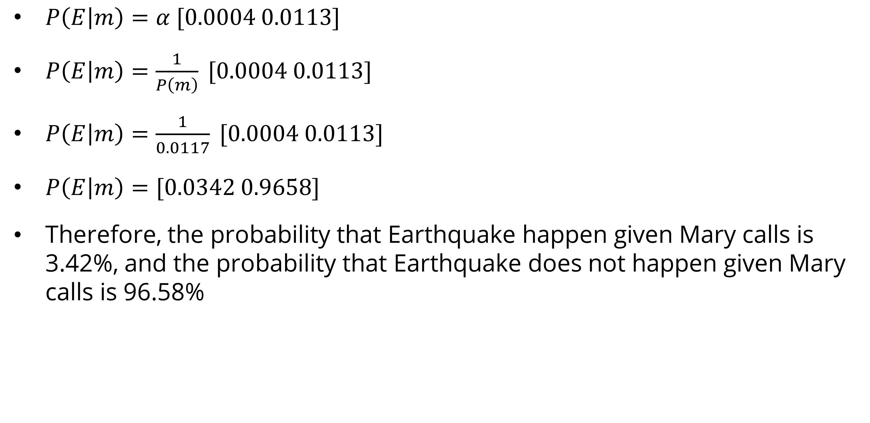
Inference by enumeration vs variable elimination
alarm network: variable elimination
$P\left(E | m\right)=α [0.0004 0.0113]$
$P\left(E | m\right)=\frac{1}{P\left(m\right)} [0.0004 0.0113]$
$P\left(E | m\right)=\frac{1}{0.0117} [0.0004 0.0113]$
$P\left(E | m\right)=[0.0342 0.9658]$
Therefore, the probability that Earthquake happen given Mary calls is 3.42%, and the probability that Earthquake does not happen given Mary calls is 96.58%

Slide 35

exercise
Bayesian network
Based on Alarm Bayesian network (slide 27), apply variable elimination to the query:
$$P\left(Burglary \right| JohnCalls=True, MaryCalls=True)$$
Count the number of arithmetic operations performed and compare it with number performed by the enumeration algorithm

Slide 36
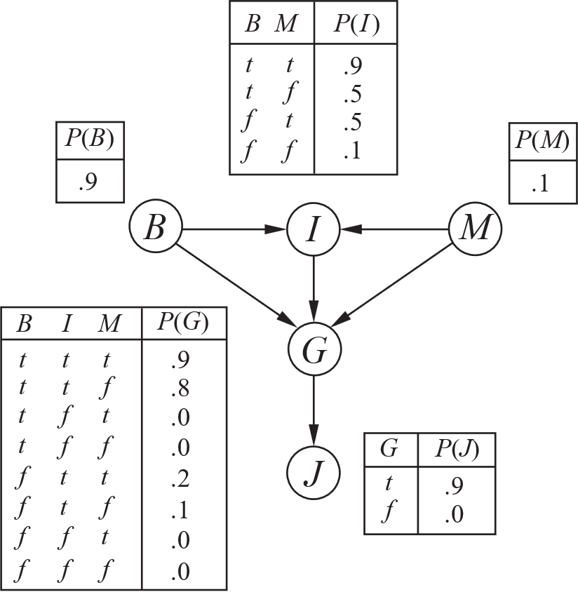
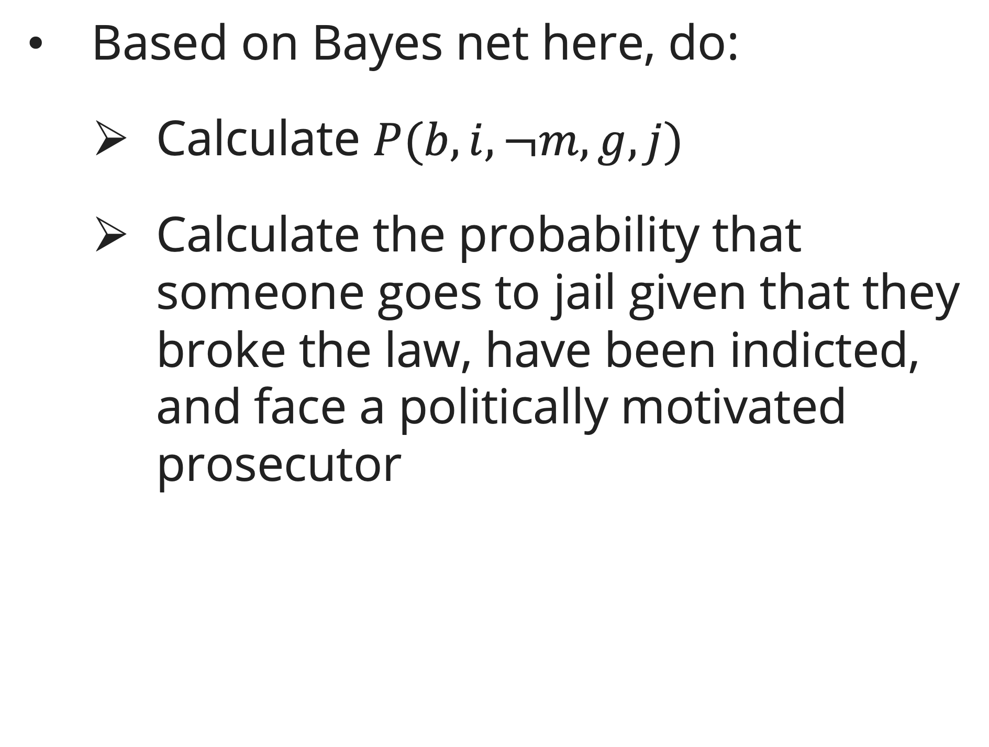
exercise
Bayesian network
Based on Bayes net here, do:
  Calculate $P(b,i,¬m,g,j)$
  Calculate the probability that someone goes to jail given that they broke the law, have been indicted, and face a politically motivated prosecutor

Slide 37
References
Session 11
Peter Norvig, Stuart Russel. (2021). Artificial Intelligence: A Modern Approach. Pearson. London. ISBN: 978-1292401133. Ch. 12-13.
Dan Klein and Pieter Abbeel. (2024). CS188 Intro to AI at UC Berkeley
Stephanie Rosenthal. (2023). CMU AI and http://ai.berkeley.edu

